Slide 1



TIAA - Retirement Industry AI Hackathon
Team Name : TechnoCrats
Dwarkadas J. Sanghvi College Of Engineering
Team Members
Mehek Jain
Pooja Gandhi
Meet Vasa
Jay Vithlani

Slide 2




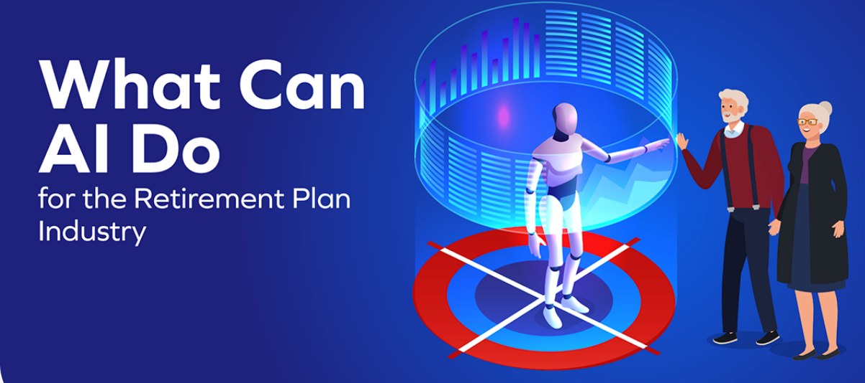

Why Do We Need Retirement Planning ?
Increased standard of living
Longetivity
Increasing Medical Costs
Early Retirement
Enjoy Early Retirement &
Peace of Mind
Inflation
1
Virtual Assistants & Chatbots
2
Enhanced Personalization
3
Efficiency & Automation
4
HealthCare Optimization
5
Predictive Insights

Slide 3
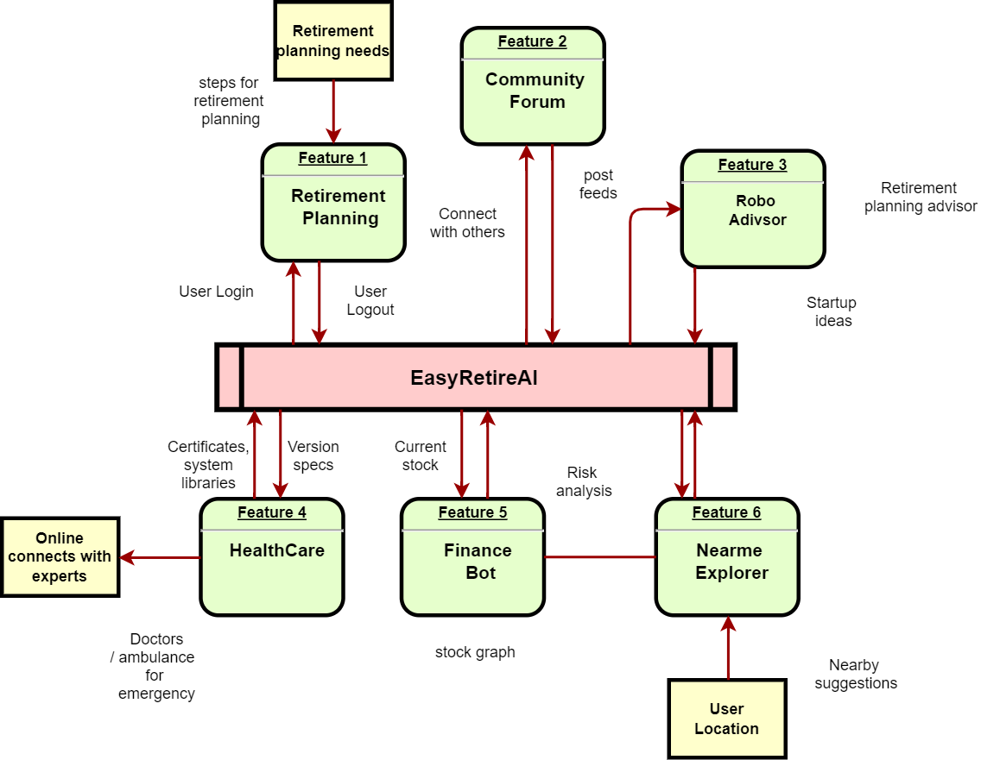
EasyRetire User Journey
Dataflow Diagram
KEY FEATURES
RETIREMENT PLANNING
COMMUNITY FORUM
ROBO ADVISOR
HEALTHCARE
FINANCE BOT
NEARME EXPLORER

Slide 4
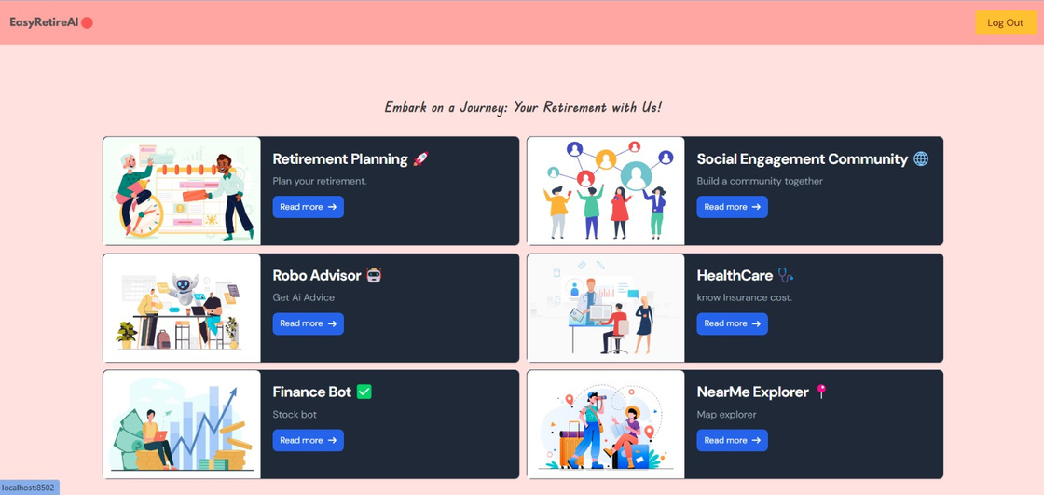

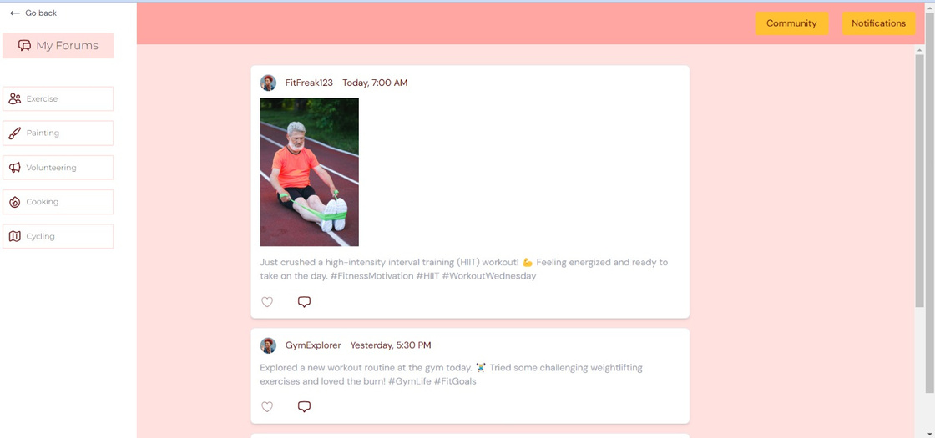

The Feature of the Perfect Retirement
1
RETIREMENT PLANNING
Explore retirement planning on our site—a concise guide to securing your future.
Learn the 'why,' 'how,' and 'where,' emphasizing advantages, importance, investments, and key tips for a prosperous post-retirement life.
2
SOCIAL ENGAGEMENT COMMUNITY
Vibrant Community Hub:
Visit and share various experiences on our
social platform. Let the Retirees get Inspired by you!!
Interactive Forums and Events:
Join discussions and events for a supportive retirement
network.

Slide 5
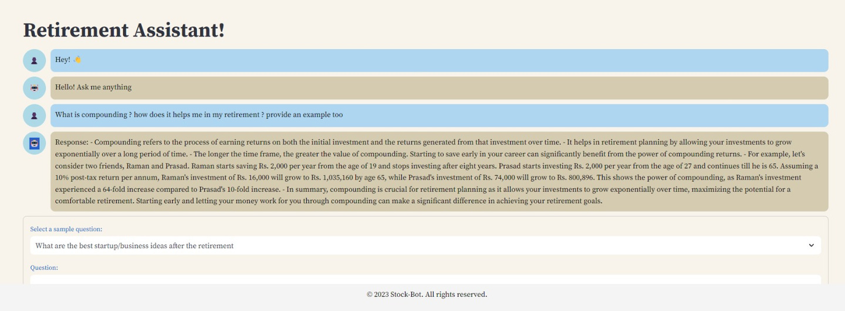
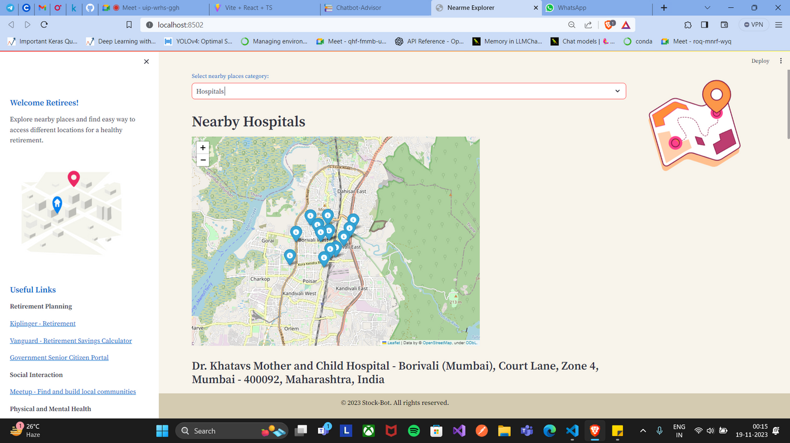
The Feature of the Perfect Retirement
3
ROBO ADVISOR
Experience versatility with our Generalized Robo Chatbot—A Multifaceted virtual assistant offering support on startup ideas for Retirees, assistance about Health Care, and ensuring comprehensive Retirement guidance at your fingertips.
4
NEAR-ME EXPLORER
Navigate your surroundings effortlessly with our Near-Me Explorer.
Providing locations Of Essential Places for a seamless retirement experience in just 2 clicks

Slide 6
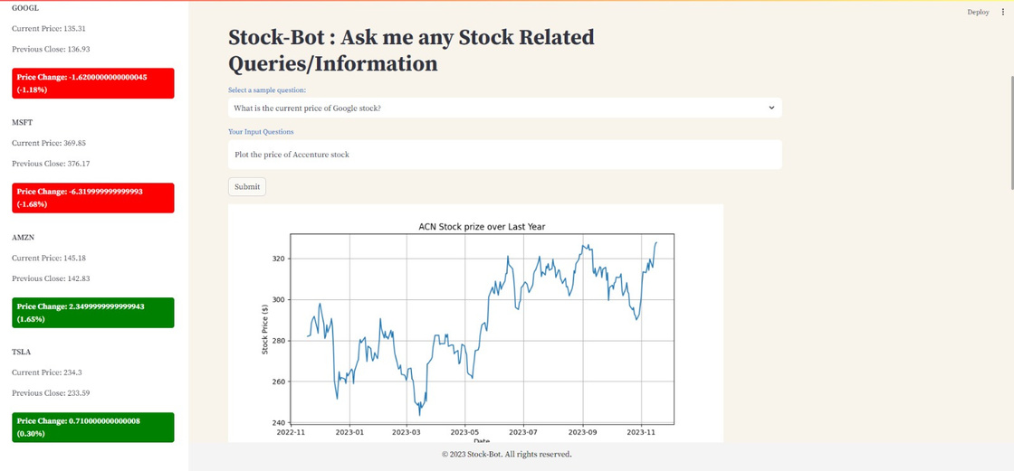
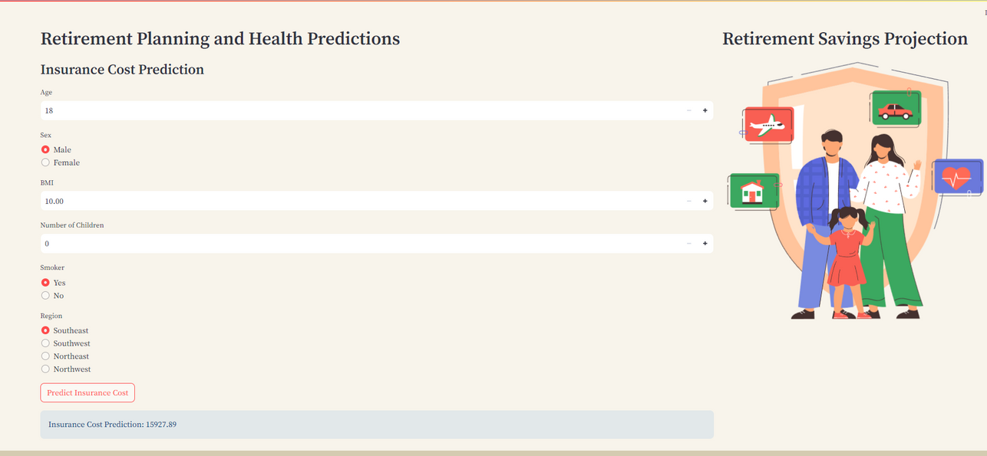
The feature of the Perfect Retirement
5
FINANCE BOT
Enhance your investment strategy with our Stock Chatbot . Explore Various Stock insights at one Place.
A virtual advisor delivering personalized stock advice and insights, Categorizing Companies based on their risks .optimizing your financial decisions for a secure and informed journey in the stock market.
6
HealthCare
Empower your retirement decisions with our healthcare section.
Featuring predictors for life expectancy and insurance cost predictors for a secure future.

Slide 7


BUSINESS PROTOTYPE
Offer premium features
Provide personalized consulting for financial and healthcare planning
Earning commissions through collaborations with financial, healthcare, and local businesses.
Subscription Model
Premium Services
Aggregate and anonymize user data for valuable business insights.
Affiliate Partnerships
Data
Insights
Partner with insurance companies, earning referral fees
Generate revenue through targeted advertising
Ad
Revenue
Insurance Partnerships

Slide 8





Tech Stack
React.js (Web Frontend) + Type Script: React.js ensures a highly responsive user interface, facilitating real-time content recommendations and engagement features
StreamLit: Streamlit is a popular Python library that is commonly used for creating web applications with minimal effort, particularly in the context of data science and machine learning.
LangCHAIN: LangChain offers seamless integration of blockchain technology with natural language processing, enabling secure and transparent interactions in a linguistically intuitive manner.
Skicit-learn & LLM : Scikit-learn provides a versatile machine learning toolkit for traditional models, while transformers like LLM (Large Language Models) such as GPT-3 offer state-of-the-art natural language understanding.

Slide 9

Future Scope
Expanded Advisory Services: Robo advisor to cover investments, insurance, and tax planning.
Expert Q&A Sessions: Host webinars for in-depth financial advice and user queries.
On-the-Go Financial Planning: Create a mobile app for seamless access to financial tools anytime, anywhere.
Personalized Strategies: Use advanced algorithms for tailored retirement plans based on individual profiles.

Slide 10
Conclusion
EasyRetire.AI AI-driven website stands as a beacon for the betterment of retirees' lives.
01
By harnessing the power of artificial intelligence, we've created a comprehensive platform tailored to enhance retirement planning, healthcare accessibility, and community engagement.
02
Through predictive models, personalized financial guidance, and easy access to essential services, our solution is dedicated to fostering financial security and well-being for retirees.
03
GitHub Repository : https://github.com/Meet3456/TIAA
Walk Through Our Demontration :
https://drive.google.com/drive/folders/1hrUWndBsPBDGrxr9bv6drd4m-u7waUiP?usp=sharing

